Slide 1
Java
Write Once, Run Anywhere

Slide 2
Java - General
What is Java?
  Java is a programming language and a platform. Java is a high level, robust, object-oriented and secure programming language.
  Java was developed by Sun Microsystems (which is now the subsidiary of Oracle) in the year 1995. James Gosling is known as the father of Java. Before Java, its name was Oak. Since Oak was already a registered company, so James Gosling and his team changed the name from Oak to Java.

Slide 3
Platform
Any hardware or software environment in which a program runs, is known as a platform. Since Java has a runtime environment (JRE) and API, it is called a platform.

Slide 4
Java Example
Simple.java
class Simple{
public static void main(String args[])
{
System.out.println("Hello Java");
}
}

Slide 5
Application
According to Sun, 3 billion devices run Java. There are many devices where Java is currently used. Some of them are as follows:
Desktop Applications such as acrobat reader, media player, antivirus, etc.
Web Applications such as irctc.co.in, javatpoint.com, etc.
Enterprise Applications such as banking applications.
Mobile
Embedded System
Smart Card
Robotics
Games, etc.

Slide 6
Types of Java Applications
There are mainly 4 types of applications that can be created using Java programming:
  1) Standalone Application
  2) Web Application
  3) Enterprise Application
  4) Mobile Application

Slide 7
Java Platforms / Editions
There are 4 platforms or editions of Java:
  1) Java SE (Java Standard Edition)
  2) Java EE (Java Enterprise Edition)
  3) Java ME (Java Micro Edition)
  4) JavaFX

Slide 8
History of Java
.The history of Java starts with the Green Team. Java team members (also known as Green Team), initiated this project to develop a language for digital devices such as set-top boxes, televisions, etc. However, it was best suited for internet programming. Later, Java technology was incorporated by Netscape.
The principles for creating Java programming were "Simple, Robust, Portable, Platform-independent, Secured, High Performance, Multithreaded, Architecture Neutral, Object-Oriented, Interpreted, and Dynamic". Java was developed by James Gosling, who is known as the father of Java, in 1995. James Gosling and his team members started the project in the early '90s.

Slide 9
Continue……
Many java versions have been released till now. The current stable release of Java is Java SE 10.
  JDK Alpha and Beta (1995)
  JDK 1.0 (23rd Jan 1996)
  JDK 1.1 (19th Feb 1997)
  J2SE 1.2 (8th Dec 1998)
  J2SE 1.3 (8th May 2000)
  J2SE 1.4 (6th Feb 2002)
  J2SE 5.0 (30th Sep 2004)
  Java SE 6 (11th Dec 2006)
  Java SE 7 (28th July 2011)
  Java SE 8 (18th Mar 2014)
  Java SE 9 (21st Sep 2017)
  Java SE 10 (20th Mar 2018)
  Java SE 11 (September 2018)
  Java SE 12 (March 2019)
  Java SE 13 (September 2019)
  Java SE 14 (Mar 2020)
  Java SE 15 (September 2020)
  Java SE 16 (Mar 2021)
  Java SE 17 (September 2021)
  Java SE 18 (to be released by March 2022)

Slide 10
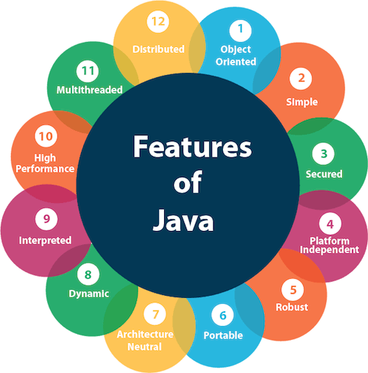
Features of Java

Slide 11
Java Example
Simple.java
class Simple{
public static void main(String args[])
{
System.out.println("Hello Java");
}
}

Slide 12
How it works…!
Compile-time Environment
Compile-time Environment
Class Loader
Bytecode
Verifier
Java Class
Libraries
Java
Source
(.java)
Java
Interpreter
Just in Time
Compiler
Java
Bytecodes
move locally
or through
network
Java
Virtual
machine
Java
Compiler
Runtime System
Java
Bytecode
(.class )
Operating System
Hardware

Slide 13
How it works…!
Java is independent only for one reason:
  Only depends on the Java Virtual Machine (JVM),
  code is compiled to bytecode, which is interpreted by the resident JVM,
  JIT (just in time) compilers attempt to increase speed.

Slide 14
THANKS

